Slide 1
Task 2
Report on the critical vulnerability found in http://zero.webappsecurity.com/
By Pauline Hannah K

Slide 2
Name of the Vulnerability : OpenSSL Unsupported Date : 22-02-2022 Domain : webappsecurity.com Subdomain : zero.webappsecurity.com Description : Here for my report I’ve used web application tests on Nessus to scan for vulnerabilities.
In this website one of the critical vulnerability found is the unsupported OpenSSL. OpenSSL is mostly used for its ability to provide secure communications over computer networks by providing encryption and server authentication. This makes it very important for the users to trust our website and visit it. And so OpenSSL is required to be upgraded to avoid being susceptible.

Slide 3
Impact : Our website is an online banking site which solely depends on users trust and confidentiality. But this outdated version of SSL could validate alternative chain certificates that could allow an attacker to impersonate our website that appears to be a legitimate site. And could make our site seem unreliable and cause a huge impact in the growth of the site. Mitigation : To upgrade the SSL visit the OpenSSL website to download the newest versions of OpenSSL; /source/index.html (openssl.org)
POC : Below I have given screenshots of Nessus report on this website to give validity of my report.

Slide 4
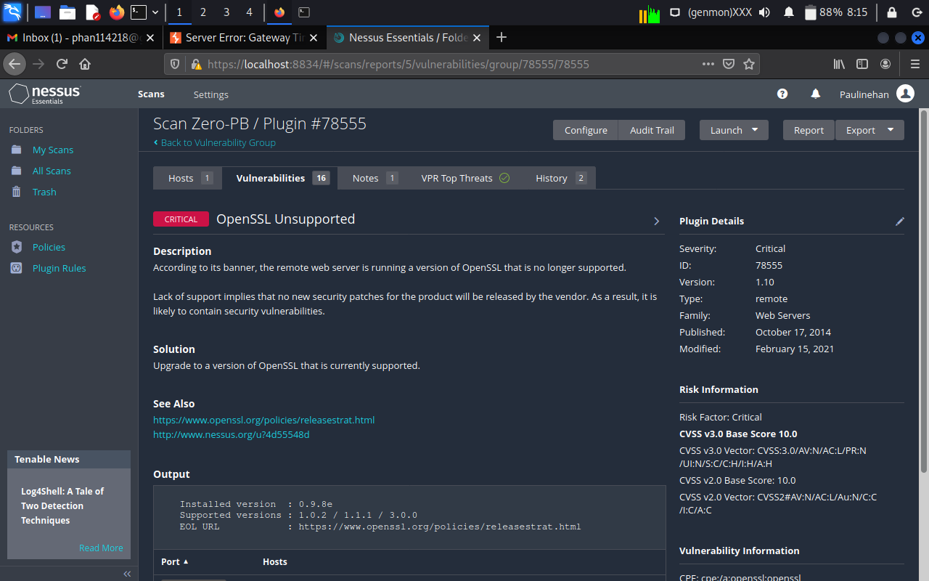
Image 1/2

Slide 5
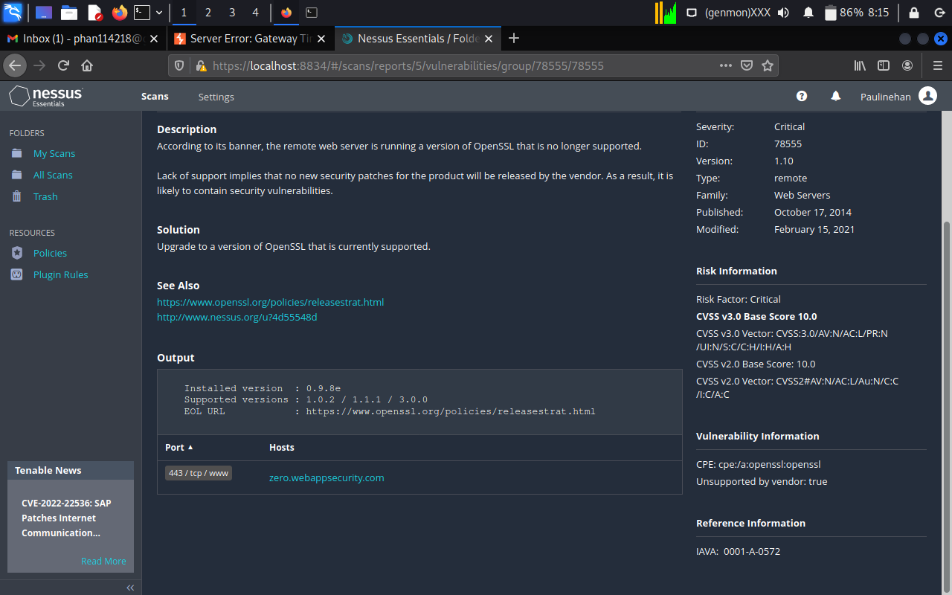
Image 2/2

